Slide 1
CORPORATE TRAINING SYSTEM
SUPERVISOR: Mr. Nguyen Huy Hung
Team member: Le Phuc Thinh
Vo Thach Nguyen
Pham Chanh Hung
Dang The Anh

Slide 2
OUTLINE
I. introduction
II. IMPLEMENTATION
III. DEMOSTRATION
IV. VALUES & Challenges

Slide 3

INTRODUCTION
1
Current Situation
2
Problems
3
Solution

Slide 4
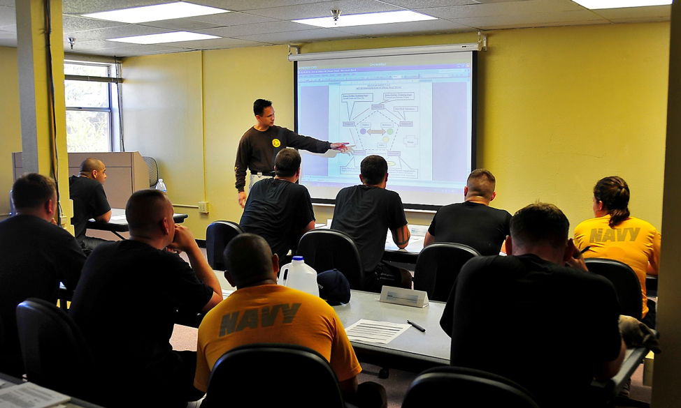
Current situation
Classroom Training
Lack of human resources to conduct classroom courses
The content of course may be duplicated
Students cannot have flexible time to study

Slide 5

Current situation
Self-study
Lack of communication
Holes in knowledge
Knots in your head

Slide 6

Current situation
Share training program online
Lack of privacy on training courses
Loss of Control
User information can be exposed to third party

Slide 7

SOLUTIONS
Provide a system for corporations to train their employees with security and conveniences.
Analyze employees’ studies to make improvements base on results.
Corporations can manage their training plans and users participated in it with ease.

Slide 8
DEMO MANAGER: CREATE plan

Slide 9




PROCESS
1. Open manage plans page
2. Click create plan
Manager
Create plan popup
Manage plans page
3. Input information
4. Change plan image overview
Manage plan

Slide 10
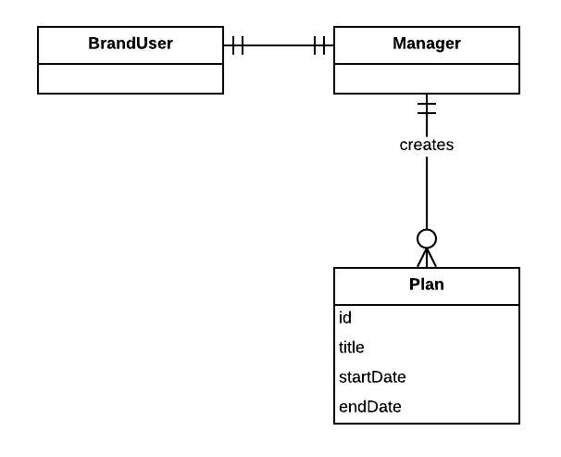
Entities

Slide 11


VALUES
Tightness and clarity. There are different specific training plans, each consisting of programs and courses related to a particular field.
Monitor everything through reports or statistics.

Slide 12

CHALLENGES
Currently only supports the web platform

Slide 13

FUTURE PLANS
Develop and improve system on mobile platforms such as iOS, Android, ...

Slide 14
THANK YOU FOR LISTENING

Slide 15


